Slide 1
BILLING ALARM

Slide 2
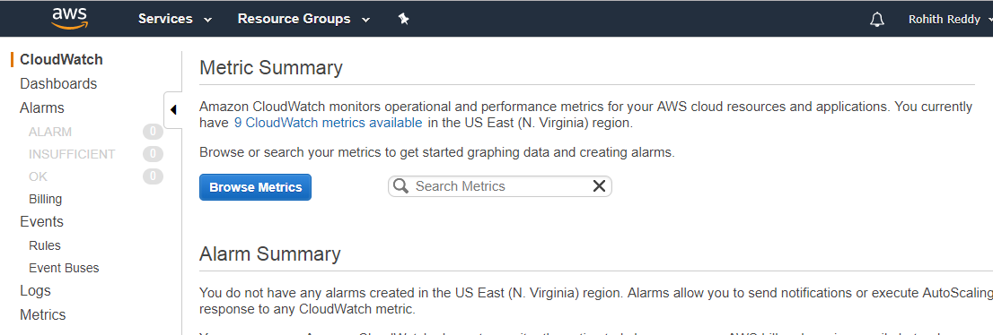
Go To CloudWatch Console.
First we need to Switch Region to US East (N.Virginia) because Cloudwatch displays all billing data and alarms in N.Virginia.

Slide 3
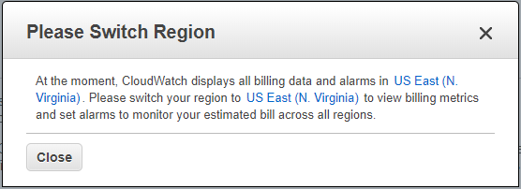
First we need to Switch Region to US East (N.Virginia) because Cloudwatch displays all billing data and alarms in N.Virginia

Slide 4
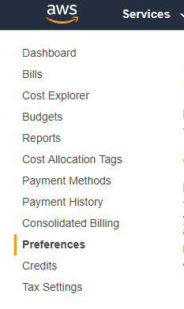
TO Create Billing Alarm in Cloudwatch you need to Turn ON the Receive billing alerts in Billing Dashboard.
Go to Billing Dashboard and select Preferences.

Slide 5
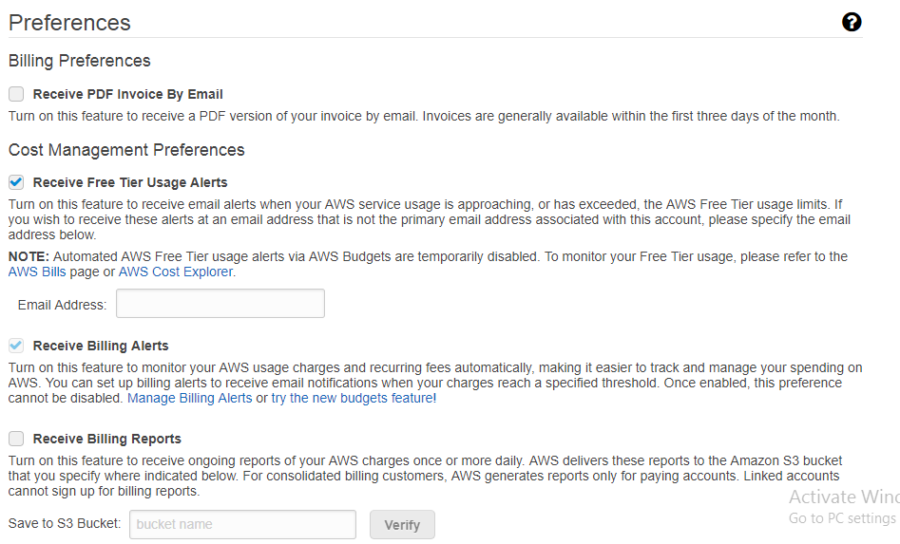
In Billing Preferences by Default to Receive Free Tier Usage Alerts is Enabled .You can Enter the Email Address to Which you want to notified.
Enable the Receive Billing Alerts and Save Preferences.
Once you Enabled the Receive Billing Alerts, you cannot disable this preference.

Slide 6
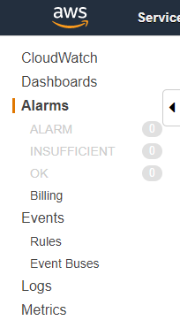
Now, go to CloudWatch Dashboard and Select the Billing Icon and it will prompt to Create Alarm.

Slide 7
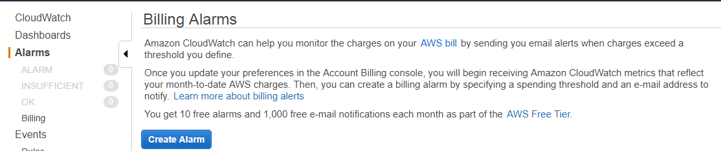
Click on Create Alarm and specify the Threshold at which you want to Notify.

Slide 8
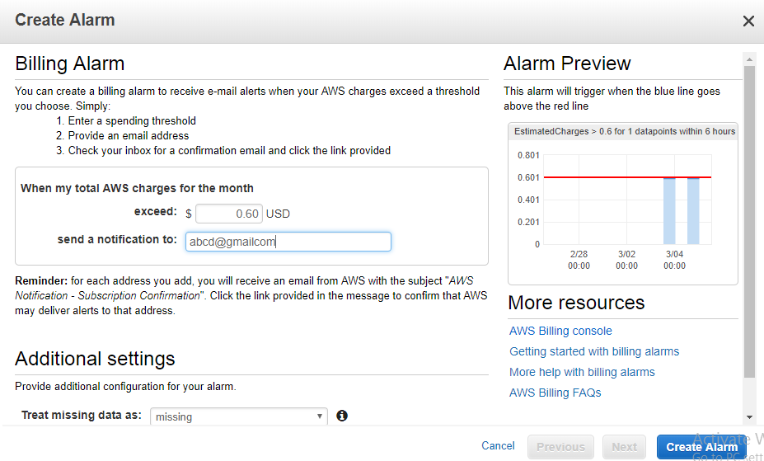
Enter the Threshold amount at which you want to Notify when it Exceeds.
Here, I have given threshold as 0.60 USD.
Next, Enter the Email Address to which Email Address you want to receive Notification.

Slide 9
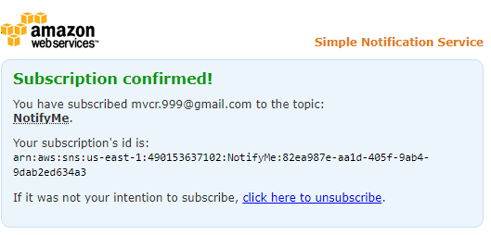
You will receive the Confirmation mail to the Email Address that you provided
Click on the Confirm Subscription.
You will below message once subscription confirmed.

Slide 10
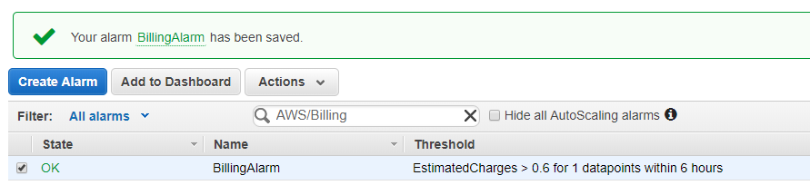
Once you Click on Create Alarm ,Billing Alarm gets created as shown below.
You will receive the Email ,once the threshold exceeded.

Slide 11
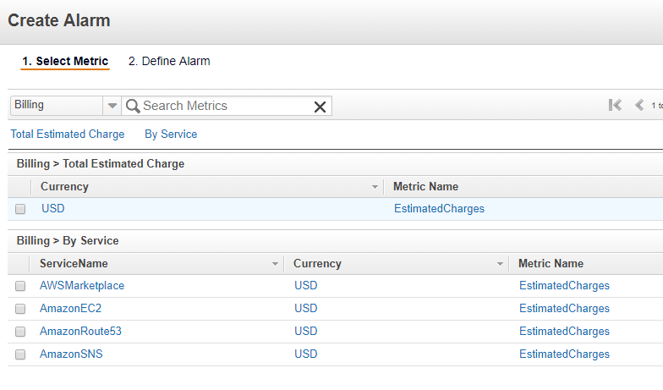
You can also Create the Billing Alarm by Service for AWSMarketplace ,EC2,Route53,SNS.

Slide 12
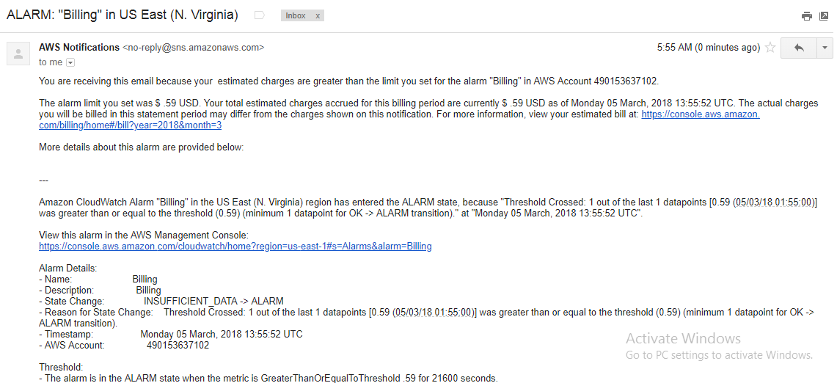
You will receive a mail or Alarm once the value hits the threshold.

Slide 13
THANK YOU

